Slide 1
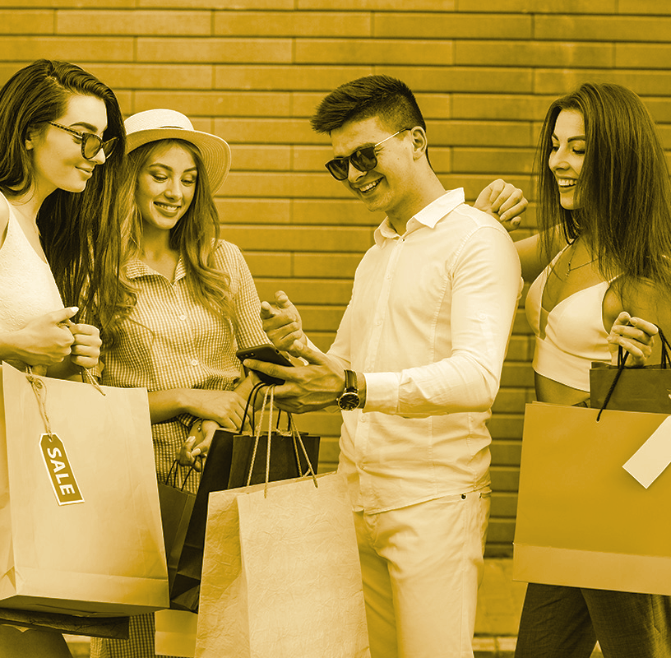
ShopRec
By Danny, Daniel, Ed, Yoon

Slide 2
CONTENTS
01
02
03
Business Overview
Model Architecture
Model Development
Business Value Motivation & Benefits
Data Processes
Data Sourcing Model Build Deployment
04
05
06
App Demonstration
Challenges & Future
Conclusion
Image Recognition Recommendation System
Challenges and Solutions Future Enhancements
Final Remarks

Slide 3
ShopRec
User Data User profiles with shopping history and preferences.
Image Recognition Image recognition captures a user’s current clothing style
Recommend Recommendations based on similar user profiles and / or clothing style
ShopRec is a Computer Vision recommendation system, used for in store personalised clothing recommendations.
ShopRec aims to personalise customer retail shopping experience, and revitalise in store shopping.

Slide 4
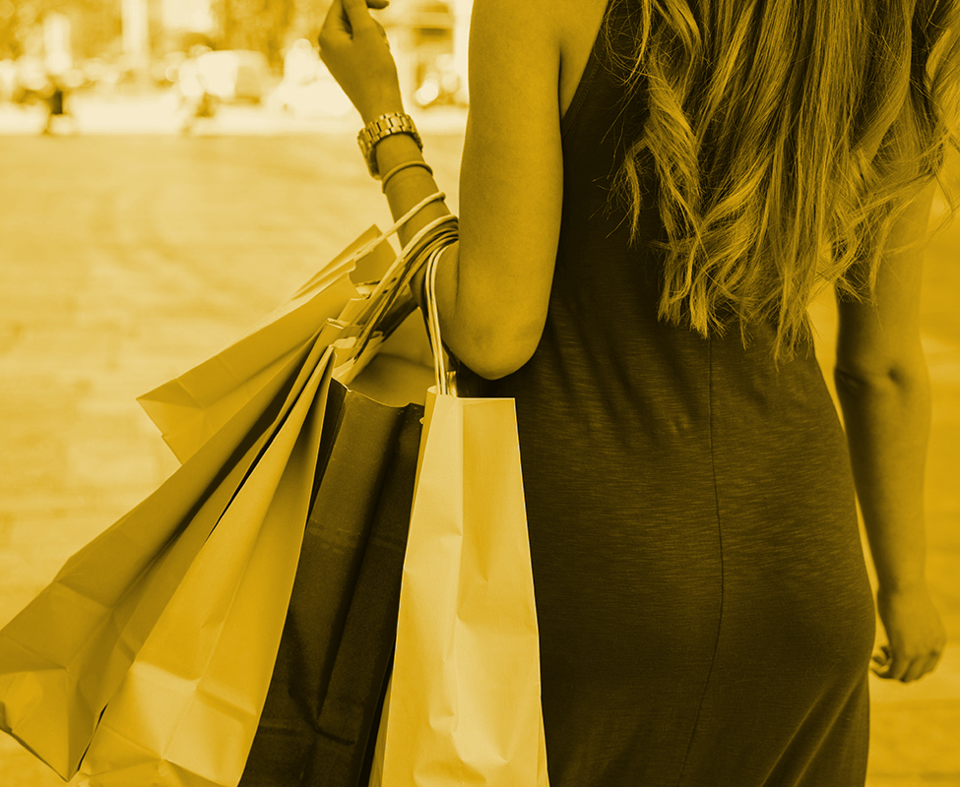
OUR MOTIVATION
Undiscovered Opportunity: Lack of multi brand / shop recommendation systems. Gap in the market for computer vision. Multiple Benefits: Customers, Shops and Shopping Centres will all benefit from innovation.
Undiscovered Opportunity: Lack of multi brand / shop recommendation systems. Gap in the market for computer vision. Multiple Benefits: Customers, Shops and Shopping Centres will all benefit from innovation.

Slide 5
BENEFITS
Customers
Personalised recommendations based on their shopping preferences.
Tailored vouchers and discount offers to spend in store.
Shops
Maintain and enhance customer loyalty.
Attract customers from complementary / partner stores.
Shopping Centres
Opportunities to attract more footfall by offering unique experiences
Increase synergy across complementary stores.

Slide 6

MISSION STATEMENT
Personalise customer retail shopping experience
Revitalise shopping centres by with computer vision

Slide 7
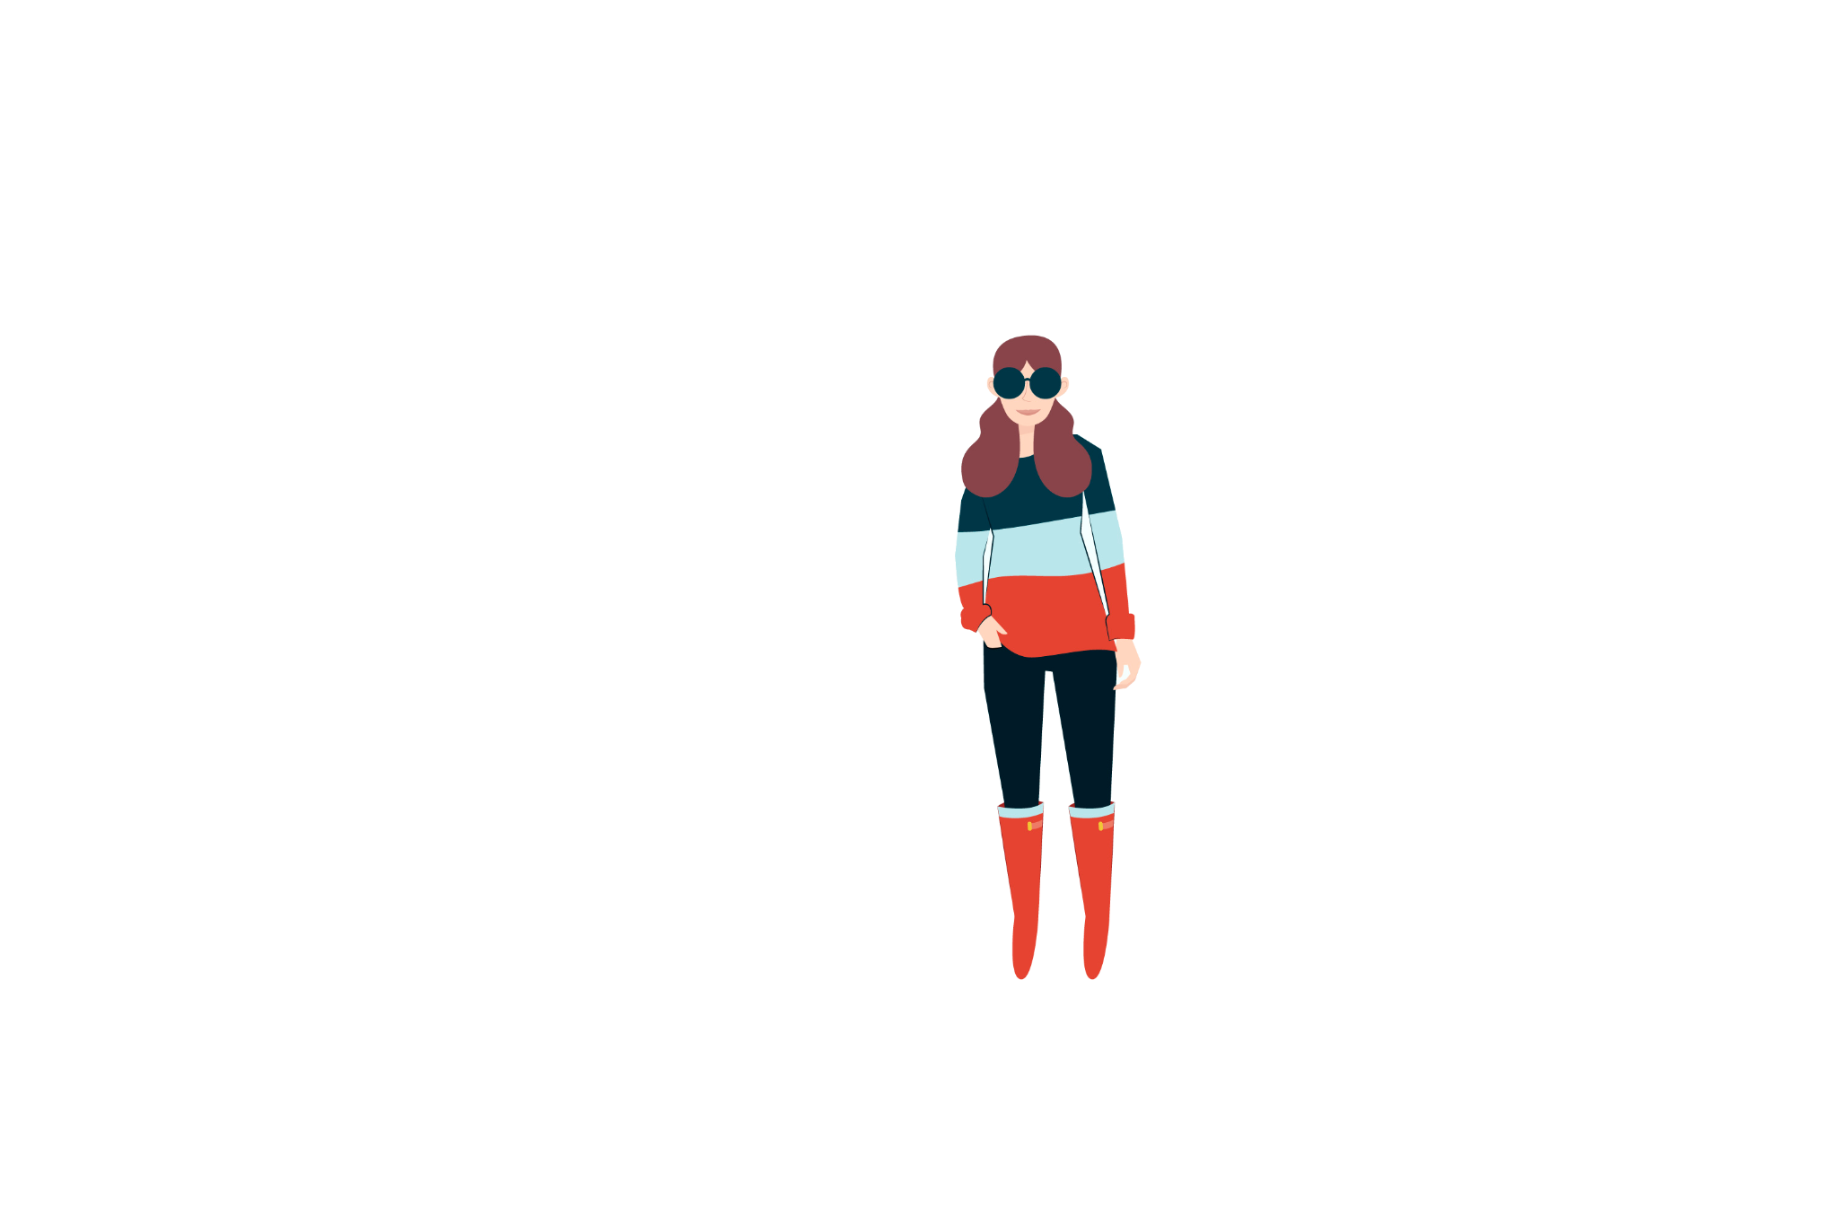
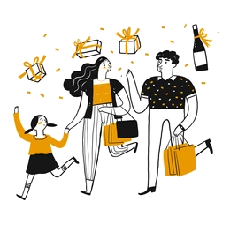
Model Architecture
Input Data
Machine Learning
Output Data
Interface detects user’s image
Databases with customer and shop product data.
User’s image is processed into Yolov5 model.
Image recognition predicts clothing items on user.
Recommendations output based on a combination of:
Nearest Neighbours
Most popular products
User clothing items
Interface
Unknown User
Yolov5 Image Recognition Model
Recommendations
Known User
Product Database
Customer Data
Recommendation System
Product names & images, Categories
ID, Gender, previous shopping history

Slide 8
Model Development
2. Data Processing
Images stored, labelled and product database created
4. Recommendation System
Algorithm created to recommend products based on similar users
1. Webscraping
Images scraped from various retailers e.g. Nike, Ralph Lauren, Uniqlo
3. Image Model Training
Yolo v5 trained on clothing images
5. Deployment
Proof of concept app deployed in Streamlit

Slide 9
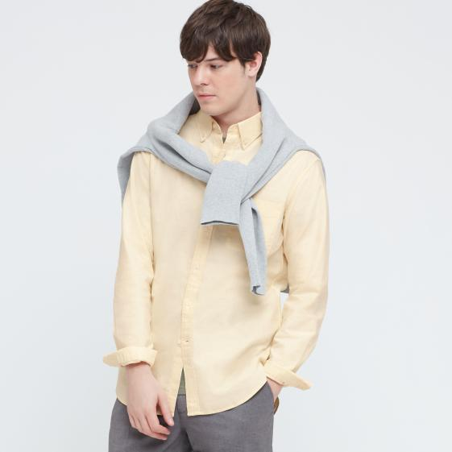
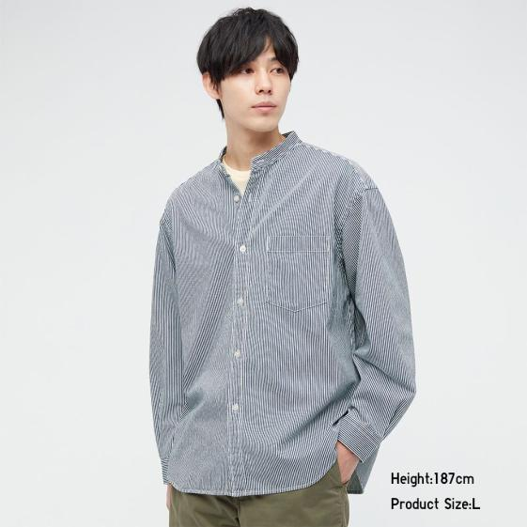
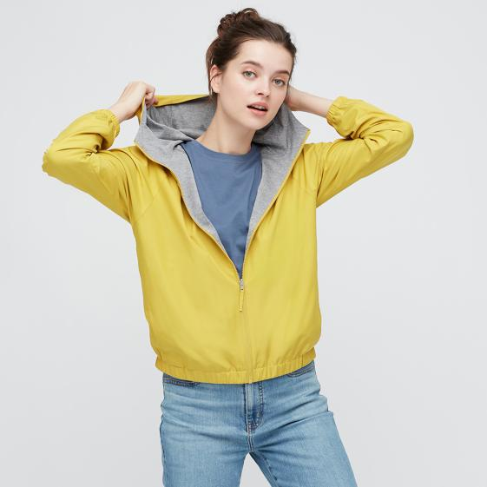
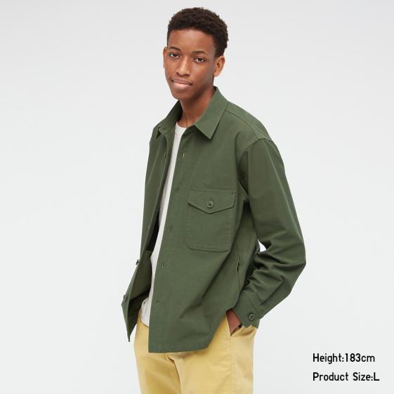
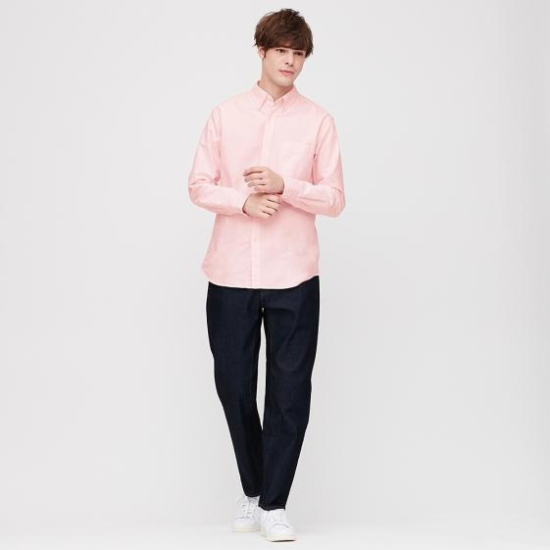
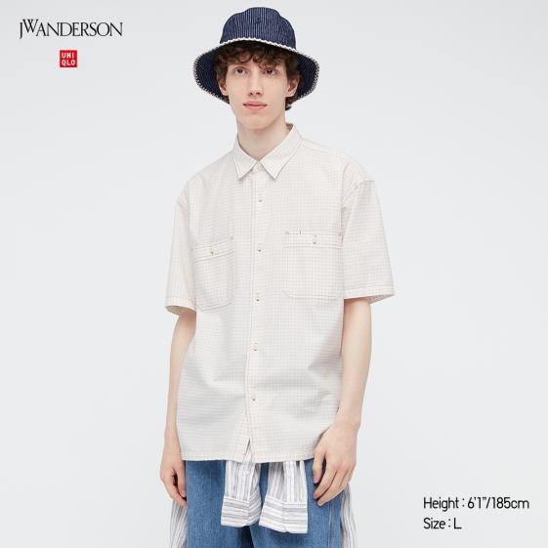
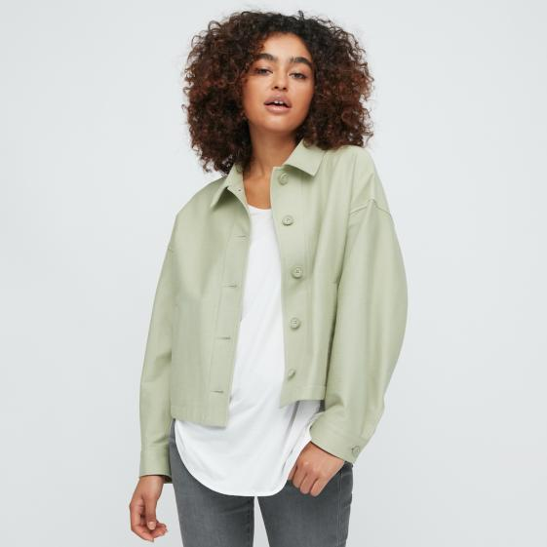
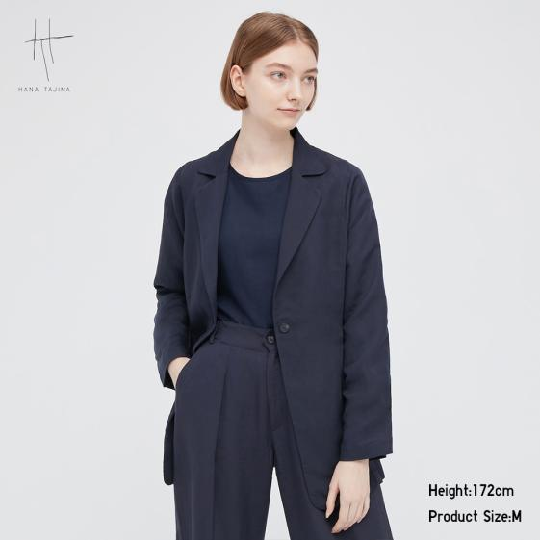
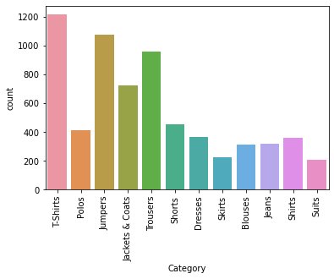
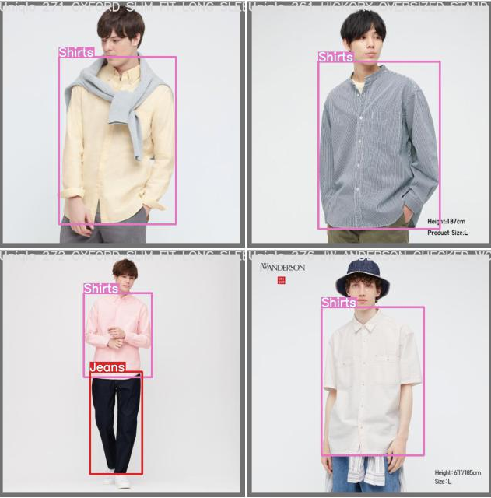
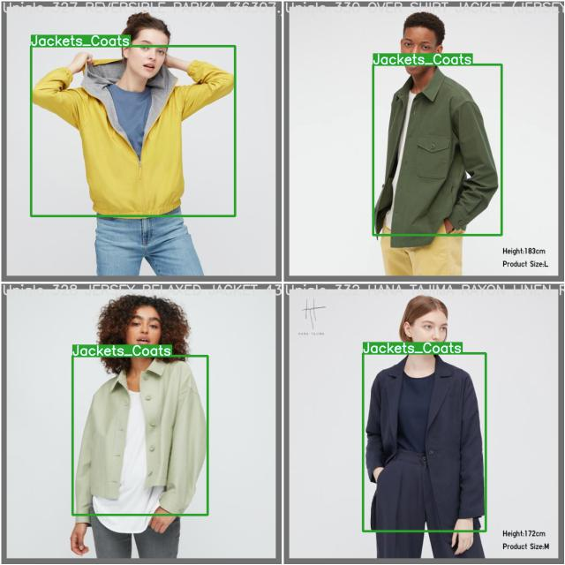
1. Webscraping
1a. Webscraping
Clothing images scraped from various retailers e.g. Nike, Ralph Lauren, Uniqlo, Calvin Klein, Max & Co, for a diverse range of male/female clothing styles.
1b. Image labelling
Images were stored, bounding boxes were drawn to label categories for use in model training.
1c. Product and Shops
12 categories of clothing, 13 stores, c. 6000 images in total

Slide 10
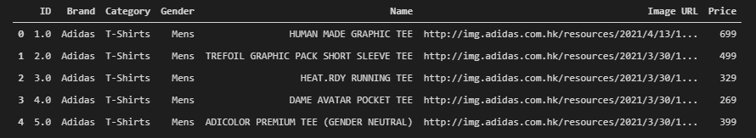
2. Data Processing
2a. Product Database
Webscraped data was cleaned e.g. similar clothing types were mapped to a consistent category
All scraped images were saved in a product database, with characteristics recorded (e.g. brand name, clothing type, gender).
Trousers
Brooks Mens Pants
Mens Trousers
Hugo Boss Mens Trousers
MEN trousers & chinos
Mens Pants
Womens Trousers
Shirts
Hugo Boss-Mens Shirts
Womens Shirts and Blouses
MEN_ dress shirts
Mens Shirts
Shirts
Womens Shirts
…

Slide 11
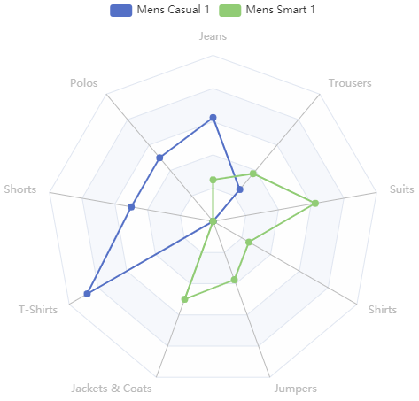
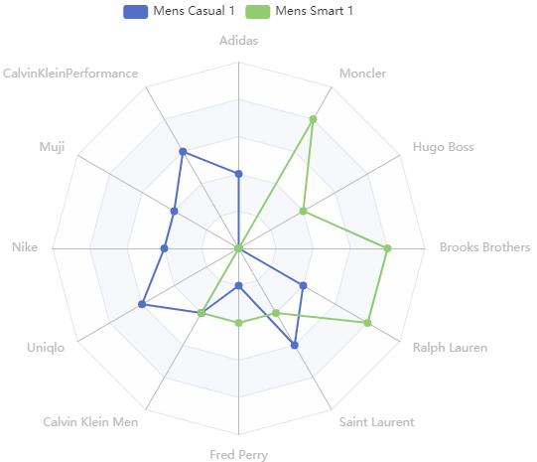
2. Data Processing
2b. User Shopping history generated
Multiple shopping personas were created to represent the distribution of clothing items purchased by customers. An example of “Men’s Casual” and “Men’s Smart” personas are shown below.
E.g. a user could shop at 50% Nike, 30% Uniqlo, 20% Fred Perry, and buying 60% T-shirts, 20% trousers, 20% jumpers.
User histories were generated using these shopping profiles and sampling the product database based on the product/shop weights. Deviations were included to prevent overfitting to the original shopping profiles.

Slide 12
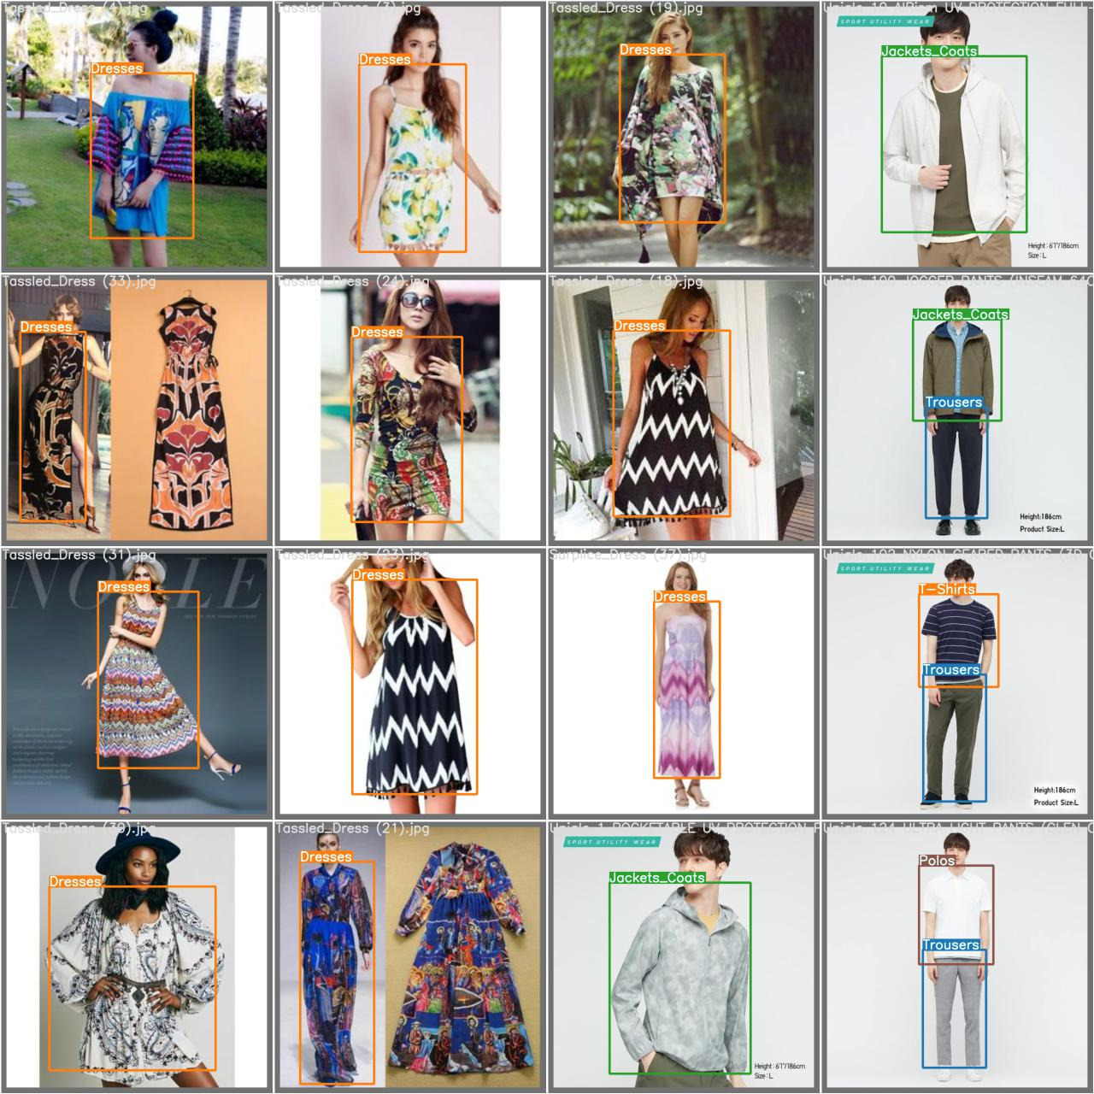
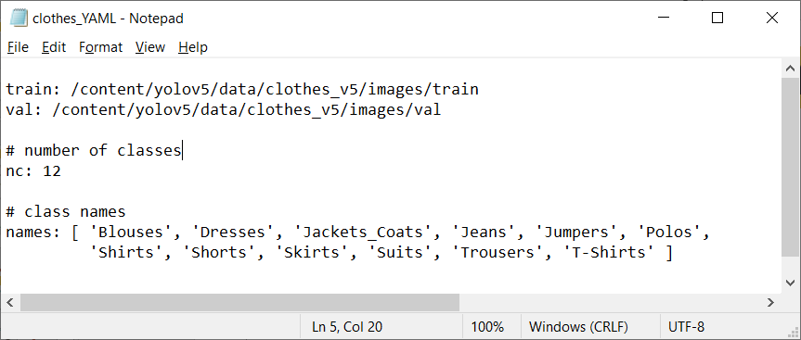
3. Model Training
3a. Overview
Yolov5 was used to train our image detection model, after several iterations the final model parameters were:
Model: Yolov5L
Train/Test/Val: 80/10/10
Epochs: 30
Batch size: 16
3b. Model Training Process
Data preparation (see previous sections)
Prepare project folder structure
Define ‘YAML’ files to specify: location of data, names and number of classes
Run model training
Export weights for later use

Slide 13
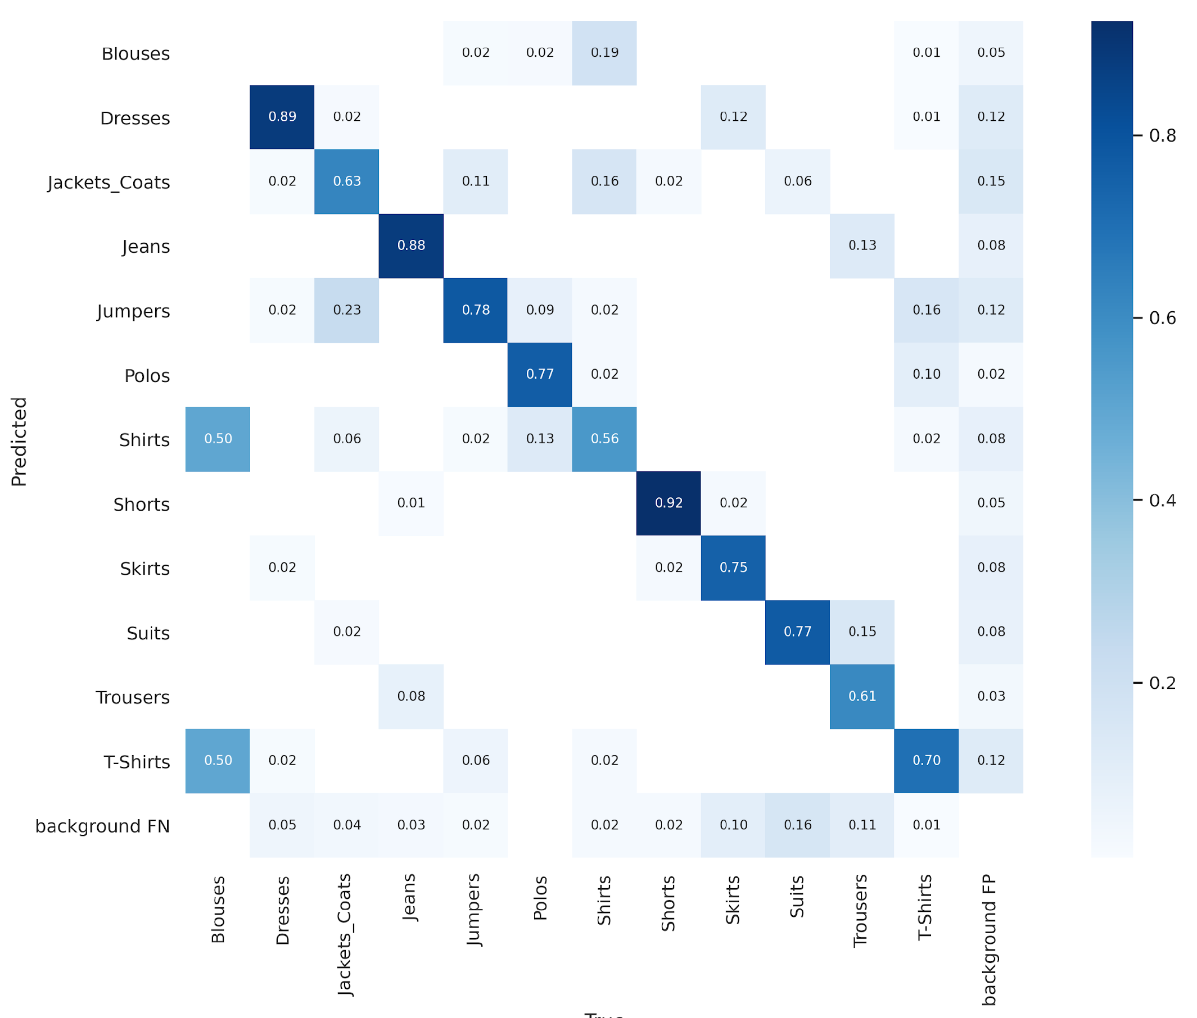
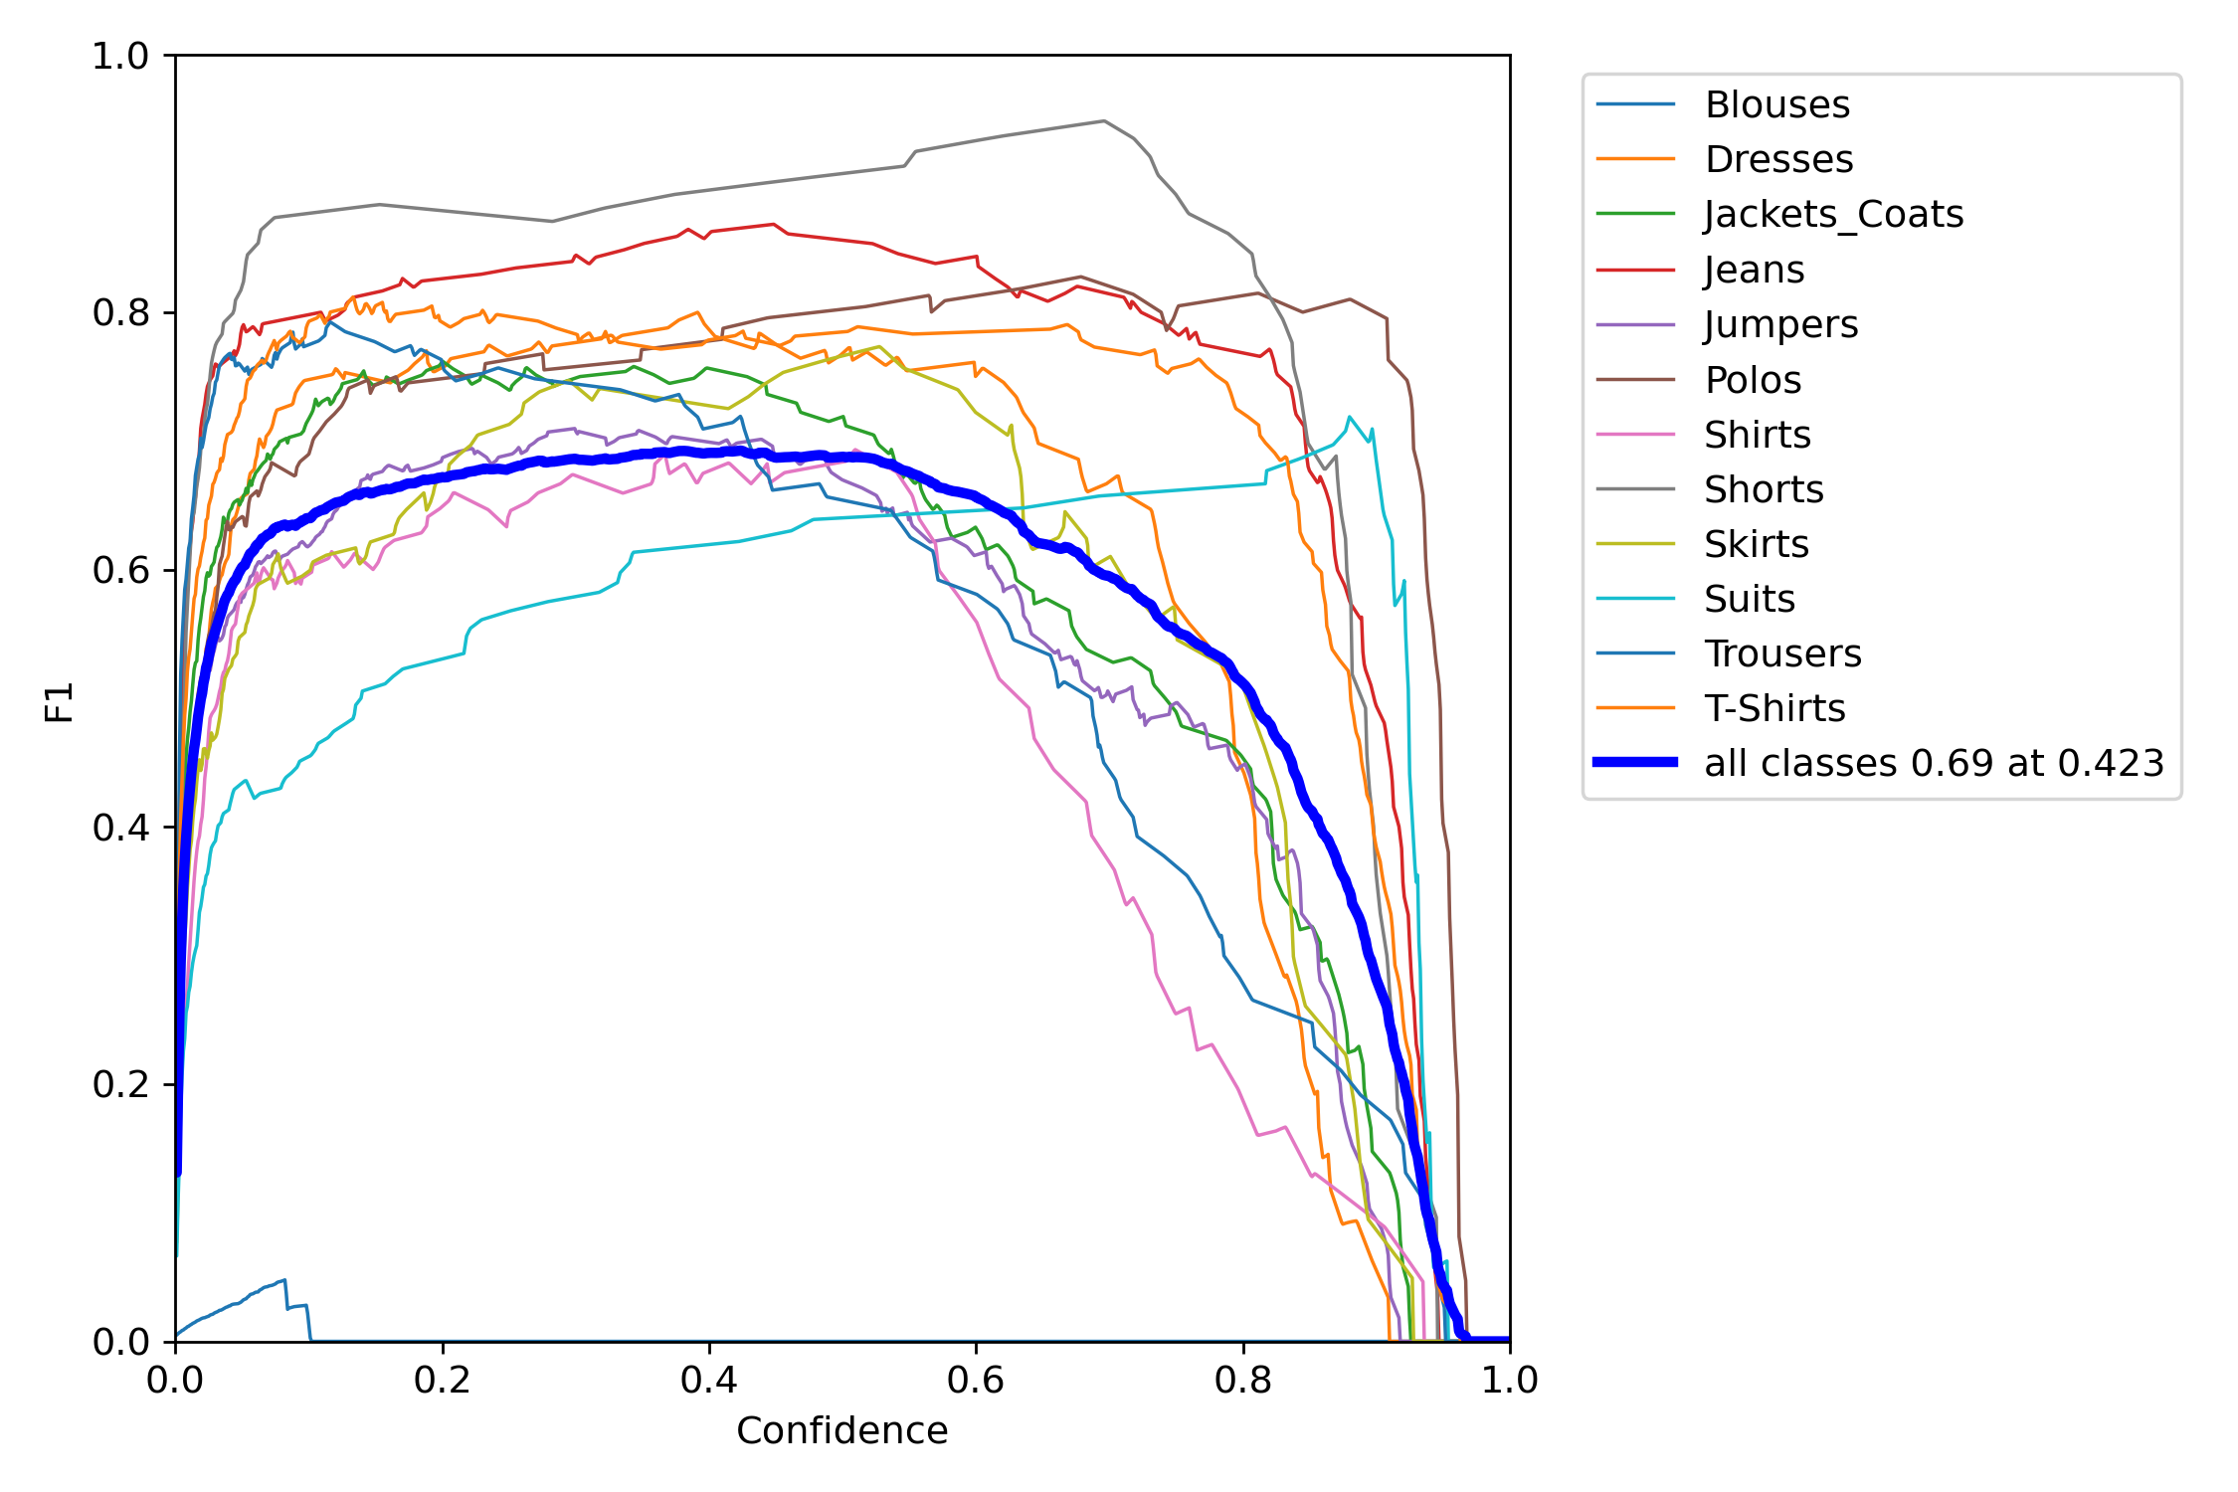
3. Model Training Results
3c. Confusion Matrix
Total average precision: 69%, recall: 73%
Confusion Matrix shows all categories generally predict well
3d. F1 Curve
The F1 curve shows the F1 score across different confidence levels, i.e. the Precision / Recall trade off in our model.
Using a 42% confidence for predictions in our model would give the best F1 score of 69%.

Slide 14
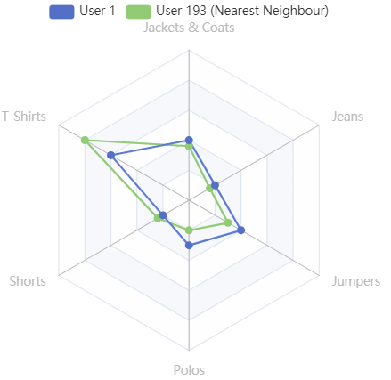
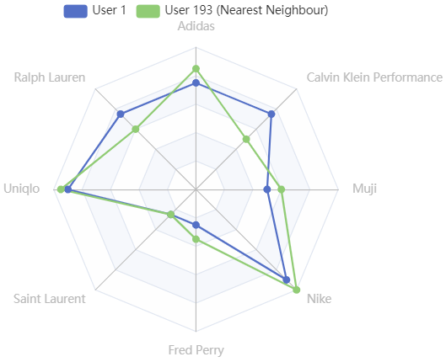
4. Recommendation System
4a. Nearest Neighbours
For user with known shopping histories, Product and Shop weightings were calculated based on Product and Shop weights.
Product weighting measures the proportion of each clothing type purchased; Shop weightings measures the proportion of clothes purchased at each shop.
Nearest Neighbours were found based on Euclidean distance to both these weightings. A static distance matrix of the distance between all known users was calculated and stored, which allowed faster calculations of nearest neighbours.
For illustration, User 1 and 193 are nearest neighbours as they both have very similar Product and Shop profiles.

Slide 15
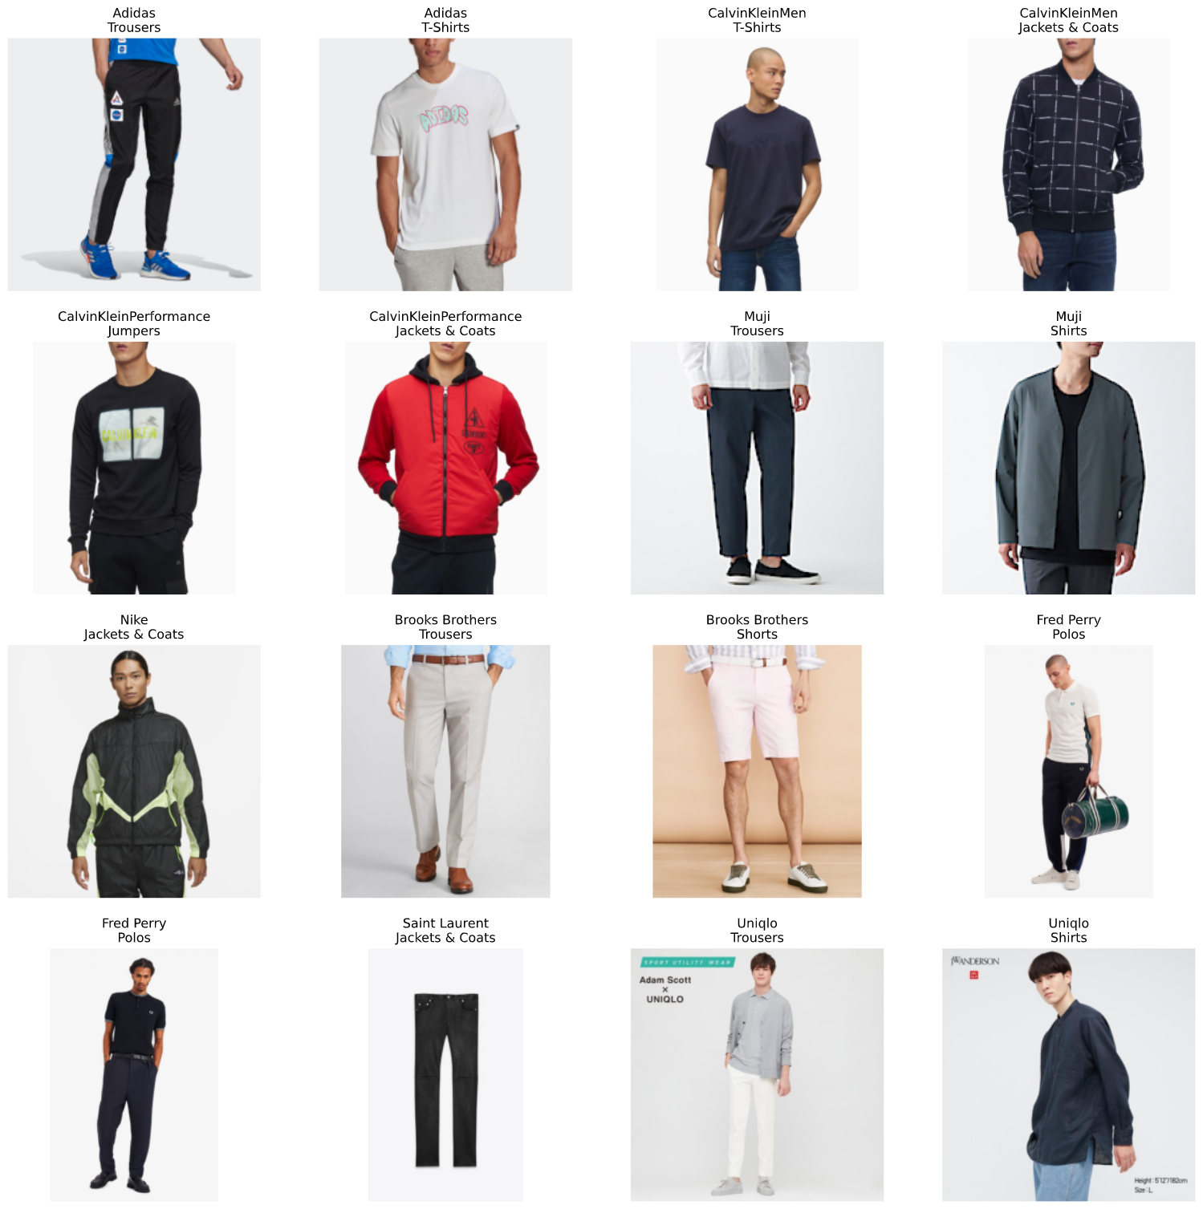
4. Recommendation System
4b. Recommendations
Once nearest neighbours are established for a user, the recommendation system works as follows:
All items bought by nearest neighbours are pooled together
Items already purchased by the user are removed
Products bought by nearest neighbours are ranked and recommended based on popularity.
Users are also able to filter their recommendation e.g. by specific stores, and/or by product type.
Example recommendations for User 1

Slide 16
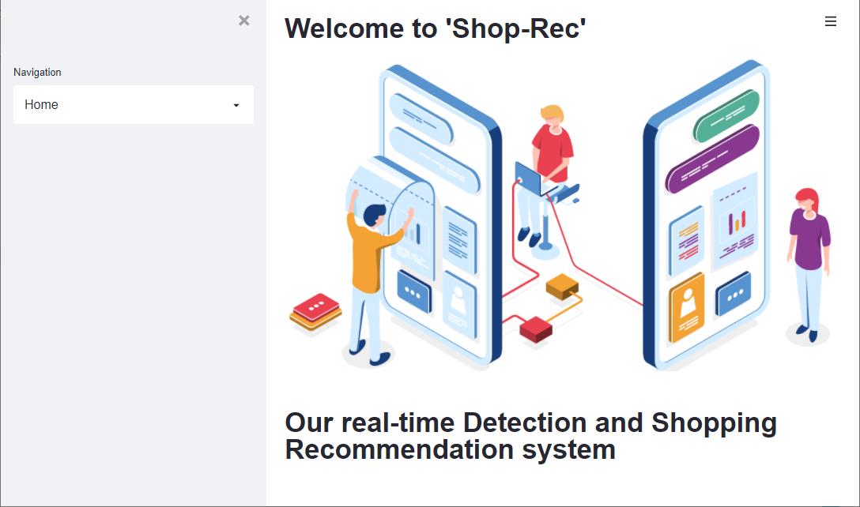
5. Deployment - Homepage
Streamlit
A proof of concept app was deployed in Streamlit due to ease of implementation.
This demonstrates functionality of image detection and recommendation system

Slide 17
5. Deployment: Video Demonstration

Slide 18
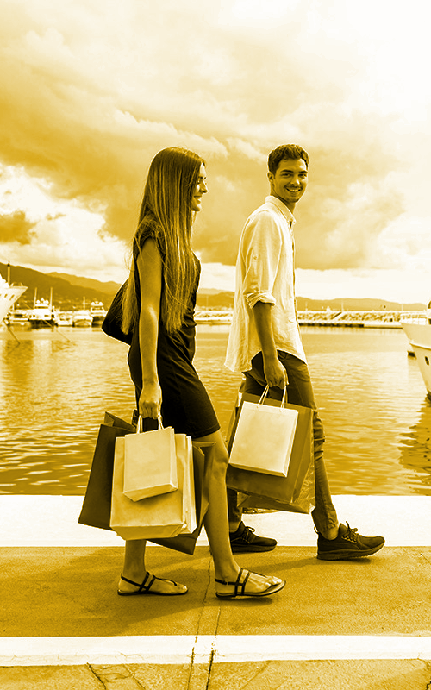
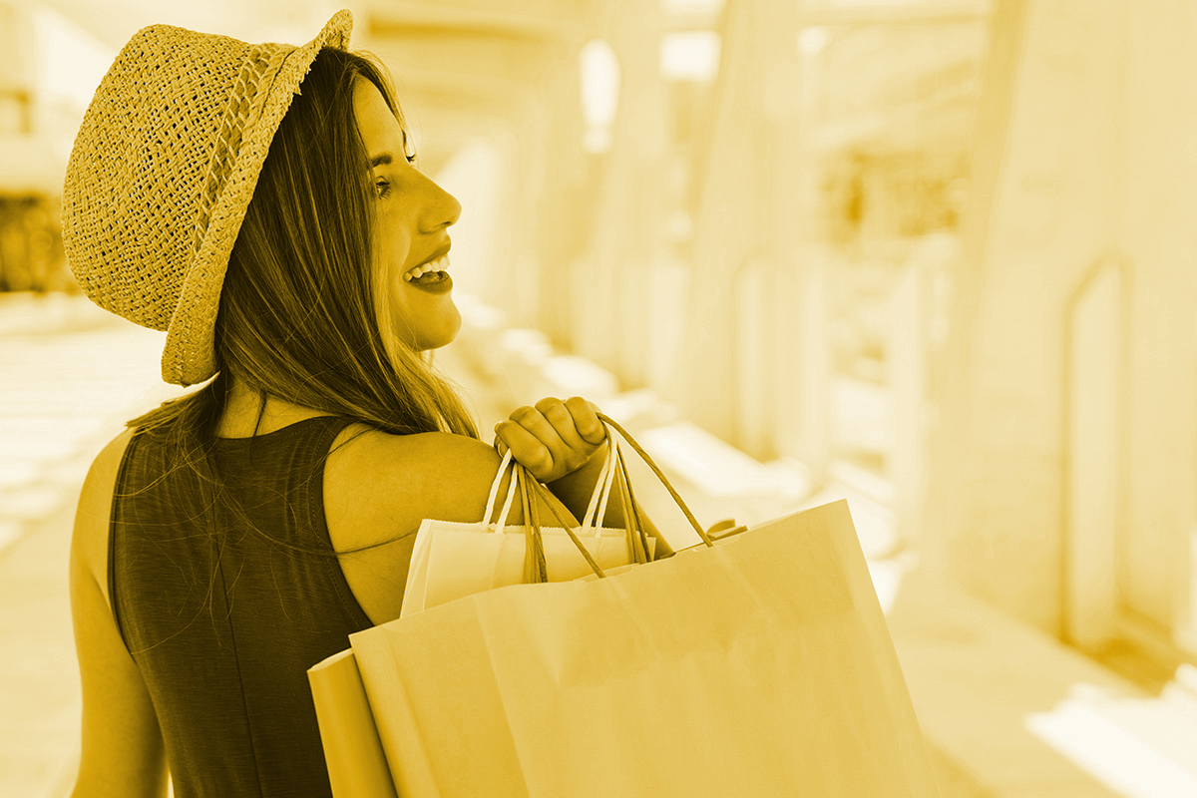
CHALLENGES
Stage | Challenge | Solution
Web scraping & Data Processing | Multiple websites with different formats, layouts and clothing category type | Standardised information required (e.g. image, shop name, clothing category, item name) Distributed web scraping to all team members
Model Training | ‘Blouses’ were too ambiguous in style and often misclassified | Removed ‘blouses’ from predictor resulting in increased accuracy across all other categories
Model Training | ‘Suits’ often misclassified, due to similarity to ‘Jackets’ | Sourced additional images for model training, resulting in increased accuracy.
User Shopping History | No real life consumer shopping history data was available. | Data was generated based on ‘user personas’, with randomness introduced to prevent overfitting.
Recommendation System | End to end recommendation calculations are time consuming. | Static consumer distance matrix saved to significantly run time.
Deployment | Identifying platform to deploy both computer vision and recommendation systems | TBC

Slide 19
FUTURE ENHANCEMENTS
Feature Extractions
Enhance image recognition model to detect and recognise clothing features e.g. style, patterns.
Initial analysis shows common features across similar items.
Expand Data and Product Range
Add more stores to broaden inventory. Include accessories and non-fashion items.
Combine with real life consumer data.
Refine Deployment
Include additional user interface features e.g. rewards scheme, user login, customer product ratings, links to websites
Consider use Django, Kivy, pyQT to deploy app.

Slide 20
CONCLUSIONS
Project & Aim
ShopRec is a Computer Vision recommendation system, used for in store personalised clothing recommendations. ShopRec aims to personalise the customer retail shopping experience, and revitalise in store shopping
Benefits
Personalised recommendations based on their shopping preferences. Maintain and enhance customer loyalty. Attract customers from complementary / partner stores.
Model Development & Performance
Yolov5 model trained on custom clothing dataset. Total average precision: 69%, recall: 73%. Recommendation systems developed on internal shopping history data
Future Enhancements
Feature Extractions Expand Data and Product Range Refine Deployment

Slide 21




THANKS!
Edward Ross
Daniel Rowbottom
Yoon Hwan Kim
Danny Zhuang

Slide 22



REFERENCES
Model Training:
Yolov5: https://github.com/ultralytics/yolov5
Pytorch: https://pytorch.org/
Deployment:
Streamlit: https://docs.streamlit.io/en/stable/api.html
Retail Industry statistics:
https://insideretail.asia/2021/03/22/hong-kong-e-commerce-set-to-grow-in-2021/
https://osome.com/hk/blog/2021-ecommerce-trends-hk/
Streamlit
Pytorch
Yolov5

Slide 23
APPENDIX

Slide 24
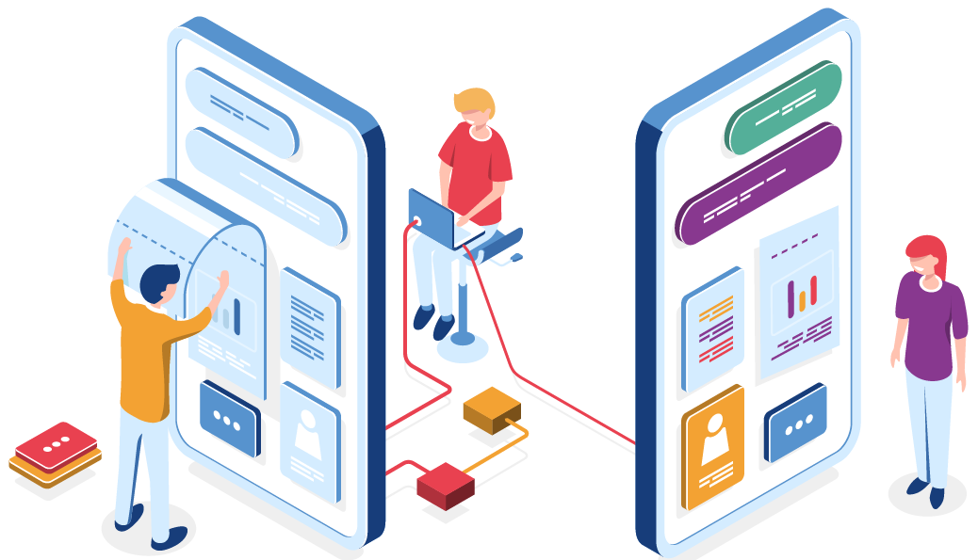
THREATS
OPPORTUNITY
E-Commerce has had strong consistent growth in recent years, supported by high Internet / smartphone penetration and consumer confidence.
Retail Shopping can innovate and use Machine Learning techniques, to provide personalised recommendation systems for in store products
Movement restrictions / lack of tourism to HK have impacted the retail industry over recent years. However, there are signs of recovery.
In store interactive computer vision interfaces will attract customers and additional traffic into stores.

Slide 25
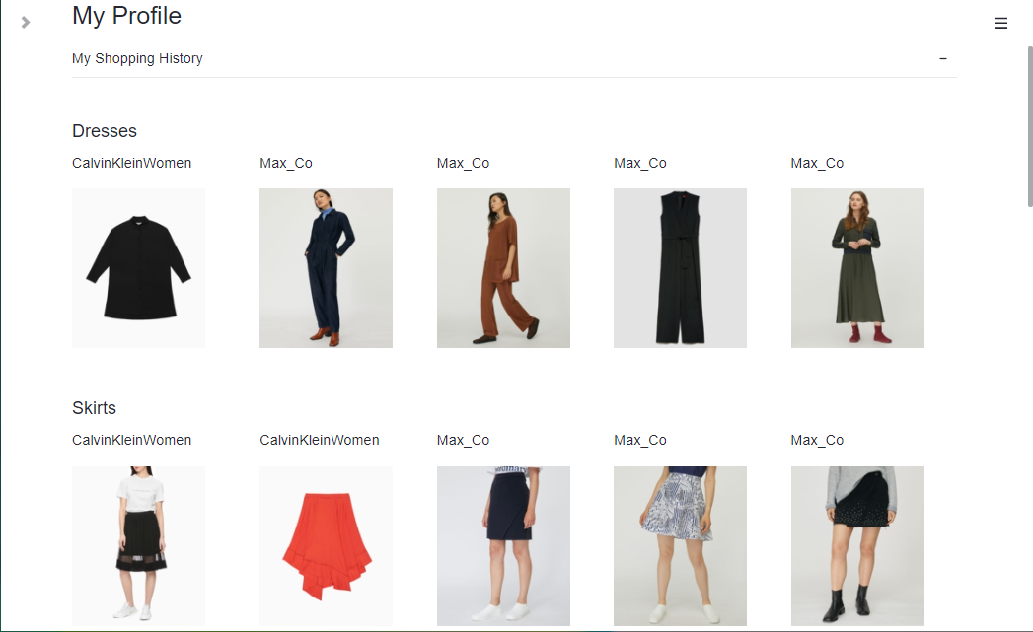
Deployment – User Profiles
User Profiles
Users can log in with their User ID
Users are then able to browse their shopping histories and most visited stores.

Slide 26
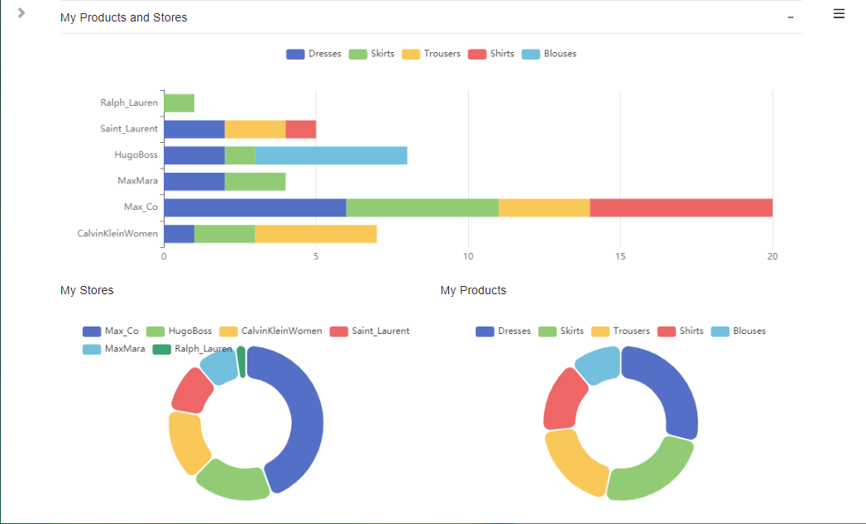
Deployment – User Profiles
User Profiles
Users can log in with their User ID
Users are then able to browse their shopping histories and most visited stores.

Slide 27
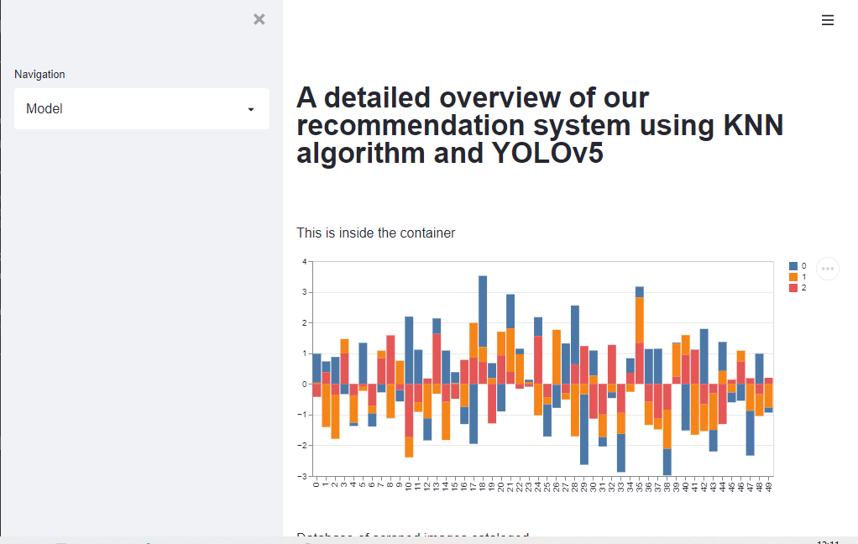
Deployment – Image Recognition
Yolov5
TBC

Slide 28
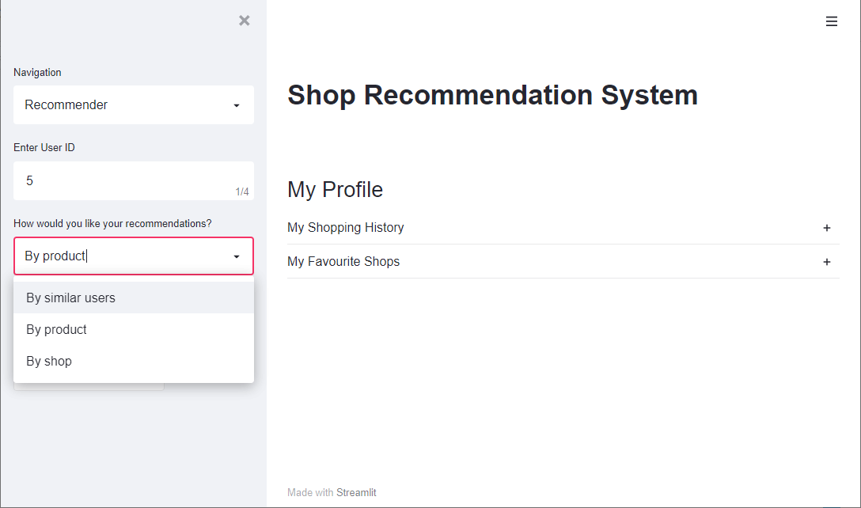
Deployment - Recommendations
Users are able to search for recommendations based on 3 approaches:
By Similar Users: Most popular items purchased by users with similar profiles. Product type and shop are not specified.
By Product: Items purchased by similar users, filtered by product type.
By Shop: Items purchased by similar users, filtered by shop.

Slide 29
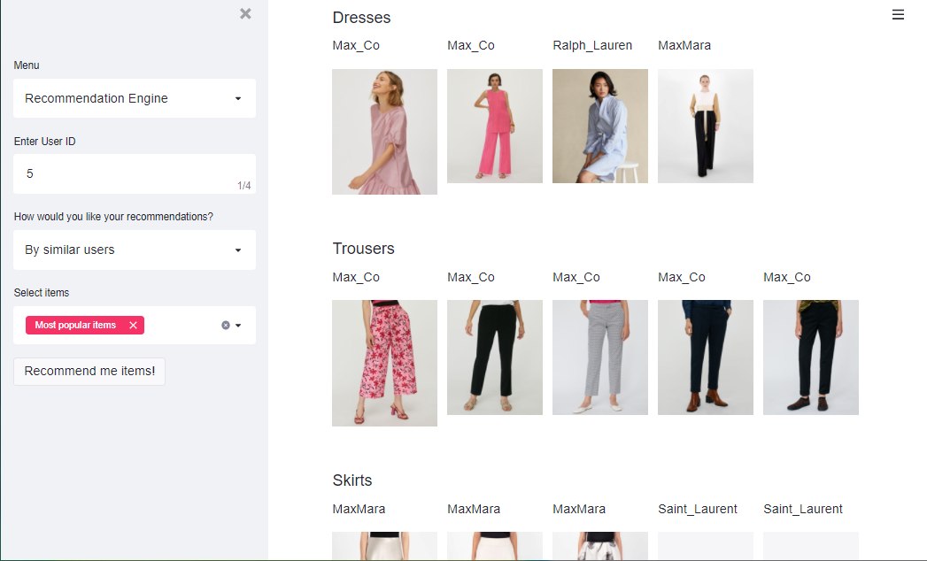
Deployment - Recommendations
Example User:
User has requested product recommendations for ‘Dresses’, ‘Skirts’ and ‘Jeans’.
Based on their and similar users’ shopping histories, this returns an assortment of items across multiple stores.

Slide 30
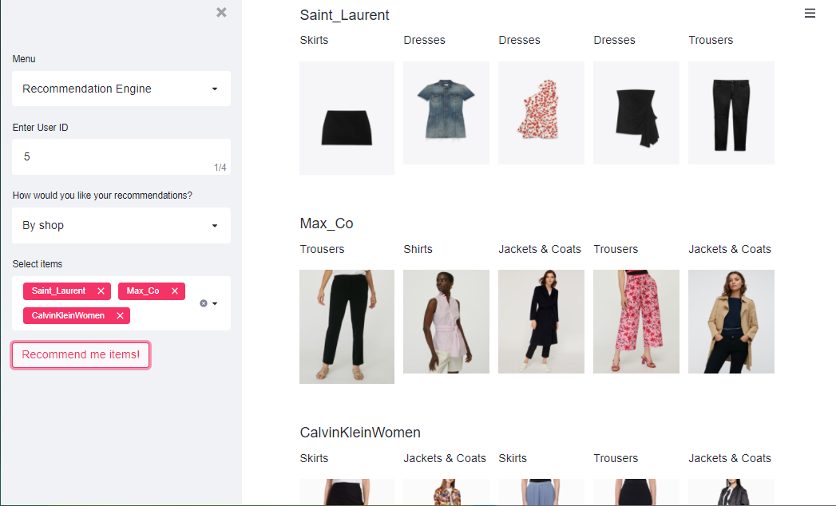
Deployment - Recommendations
Example User:
User has requested product recommendations for ‘Dresses’, ‘Skirts’ and ‘Jeans’.
Based on their and similar users’ shopping histories, this returns an assortment of items across multiple stores.

Slide 31
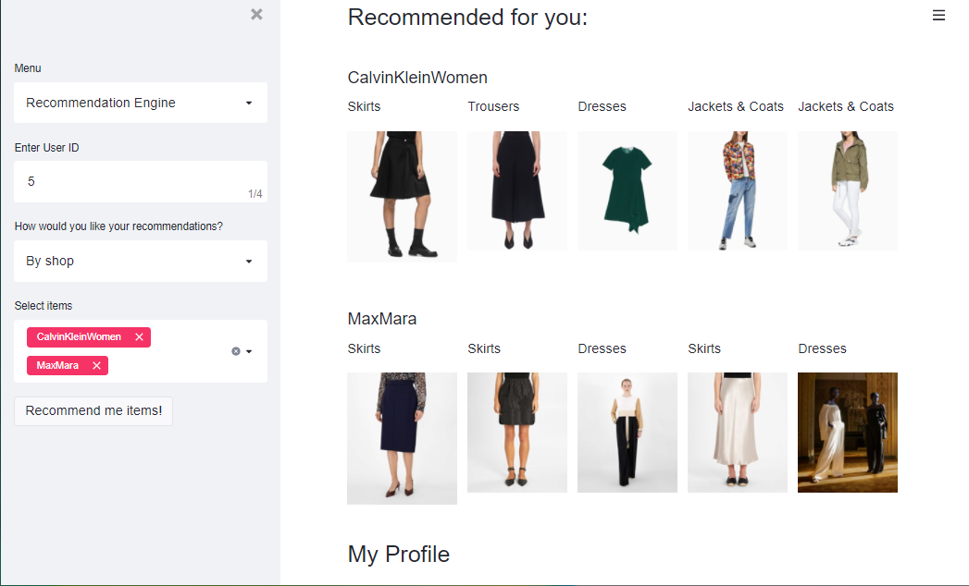
Deployment - Recommendations
Example User:
User has requested shop recommendations for ‘Calvin Klein Women’ and ‘MaxMara’.
Based on their and similar users’ shopping histories, this returns an assortment of items across multiple product types.

